Slide 1
Decision Trees

Slide 2
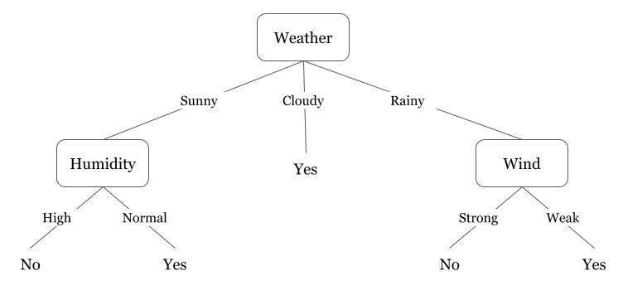
Introduction
Basic idea behind building a decision tree is to map all the possible decision paths in the form of a tree.

Slide 3
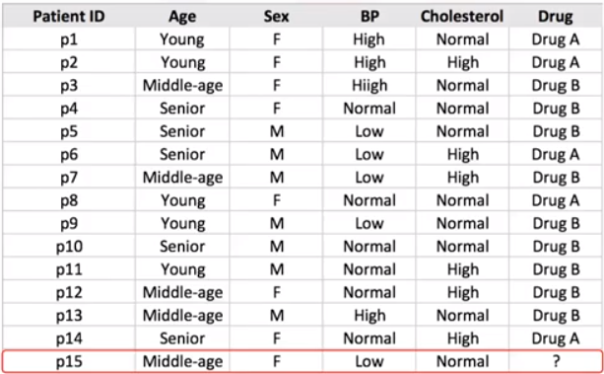
Case Study: Drug Prediction
Suppose you’re a medical researcher compiling data for a study.
During their course of treatment, each patient responded to one of two medications; we’ll call them Drug A and Drug B.
Your job is to build a model to find out which drug might be appropriate for a future patient with the same illness.
Feature sets: Age, Gender, Blood Pressure, and Cholesterol
Target: Drug that each patient responded to.
Features
Target

Slide 4
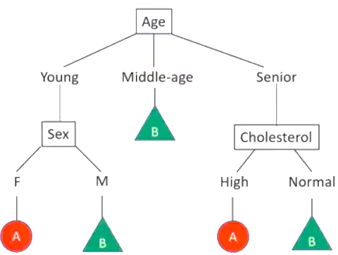

Decision Tree
It is a sample of binary classifiers.
Internal node: Test
Branch: Test result
Leaf Node: Patient Class (classification)

Slide 5
How to Build Decision Tree ?
Choose an attribute from dataset.
Calculate the significance of the attribute (effective attribute) in the splitting of the data.
Split the data based on the value of the best attribute.
Then, go to each branch and repeat Step 1 for the rest of the attributes.
Once your tree is build, you can use it to predict the class of unknown cases (ex. Proper Drug for new patient), based on his/her characteristics.

Slide 6
How to select the effective attribute ?
The algorithm chooses the most predictive feature to split the data on.

Slide 7

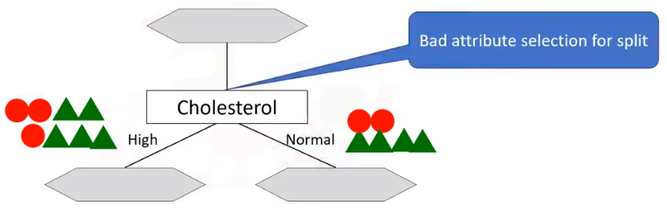
Effective Attribute Quest!
Let’s begin our quest by picking “Cholesterol” as the first attribute to split data.
It is a sample of bad attribute selection for splitting data.

Slide 8
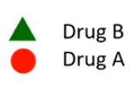
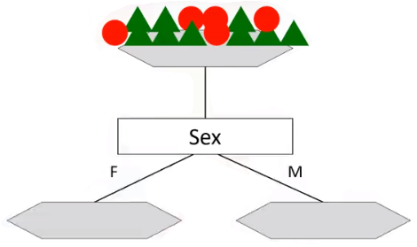
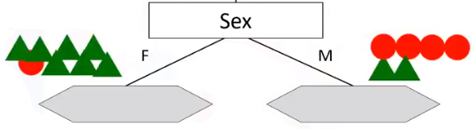
Let’s try with “sex” attribute of patients.
However, it is still a better choice in comparison with the “Cholesterol” attribute, because the result in the nodes are more pure, i.e. nodes which are either mostly Drug A or Drug B.
Thus, it’s more predictive than the other attributes.

Slide 9

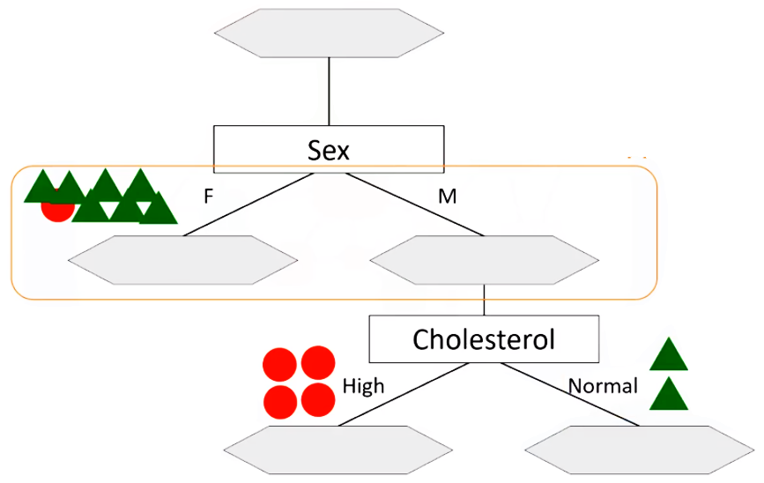
Predictiveness is based on decrease in “impurity” of nodes.
So, the “Sex” feature is a good candidate in the following case, because it almost found the pure patients.
We test “Cholesterol” again here.
As you can see, it results in even more pure leaves.
So, we can easily make a decision here.
Pure Node

Slide 10
In fact, the method uses recursive partitioning to split the training records into segments by minimizing the “impurity” at each step.
”Impurity” of nodes is calculated by “Entropy” of data in the node.
So, what is “Entropy”?
Entropy is the amount of information disorder, or the amount of randomness in the data.
In decision trees, we're looking for trees that have the smallest entropy in their nodes.
Lower the Entropy, distribution is less uniform and nodes are more pure!

Slide 11
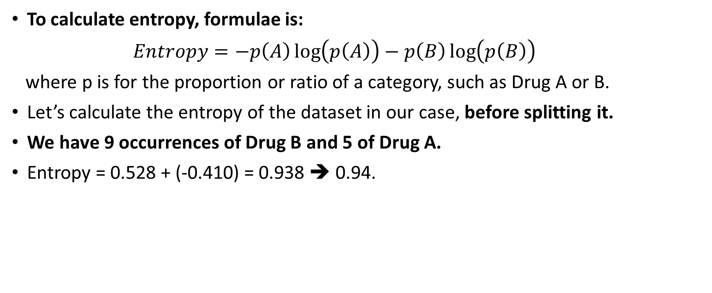
To calculate entropy, formulae is:
$Entropy=−p\left(A\right)\log\left(p\left(A\right)\right)−p\left(B\right)\log\left(p\left(B\right)\right)$
where p is for the proportion or ratio of a category, such as Drug A or B.
Let’s calculate the entropy of the dataset in our case, before splitting it.
We have 9 occurrences of Drug B and 5 of Drug A.
Entropy = 0.528 + (-0.410) = 0.938 ➔ 0.94.

Slide 12
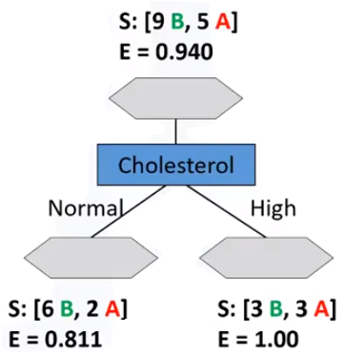
Calculate the entropy at each node (for each Attribute)
Consider all the attributes and calculate the “Entropy” after the split, and then chose the best attribute.

Slide 13
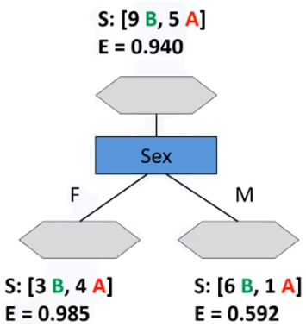
Calculate the entropy at each node (for each Attribute)

Slide 14
Information Gain
Before taking our splitting decision, lets understand Information Gain!
Information gain is the information that can increase the level of certainty after splitting.
As entropy, or the amount of randomness, decreases, the information gain, or amount of certainty, increases, and vice-versa.
So, constructing a decision tree is all about finding attributes that return the highest information gain.

Slide 15


Comparison of Attributes

Slide 16
Question
Between the Cholesterol and Sex attributes, which one is a better choice?
Which one is better as the first attribute to divide the dataset into 2 branches?
Which attribute results in more pure nodes for our drugs?
Answer:
“Sex” attribute

Slide 17
Repeat!
So, we select the “Sex” attribute as the first splitter.
Now, what is the next attribute after branching by the “Sex” attribute?
We should repeat the process for each branch, and test each of the other attributes to continue to reach the most pure leaves.
This is the way that you build a decision tree!

Slide 18
Python Hands-on Session
Imagine that you are a medical researcher compiling data for a study. You have collected data about a set of patients, all of whom suffered from the same illness. During their course of treatment, each patient responded to one of 5 medications, DrugA, DrugB, DrugC, DrugX and DrugY. Part of your job is to build a model to find out which drug might be appropriate for a future patient with the same illness. The feature sets of this dataset are Age, Sex, Blood Pressure, and Cholesterol of patients, and the target is the drug that each patient responded to.

Slide 19

Please contact
Foundation for Innovation and Collaborative
Education
mentor@fice.in
www.fice.in
Please contact
Foundation for Innovation and Collaborative
Education
info@fice.in
mentor@fice.in
Notes:
Here are the lessons we are going to learn today.

